Slide 1
Alexa Voice Query and Web Application for Querying Based on AWS
Yunao Shen
Xinyang Wang
Yan Gu

Slide 2
Alexa Voice Input Workflow
First, user starts querying Instacart database using voice input in Alexa Developer Console.
Voice input is parsed by Alexa and sent to AWS lambda endpoint in json format.
Lambda function is triggered and generate SQL statements.
Send the SQL to the web server and store it. Retrieve it when in need. User could modify the SQL before running it.

Slide 3
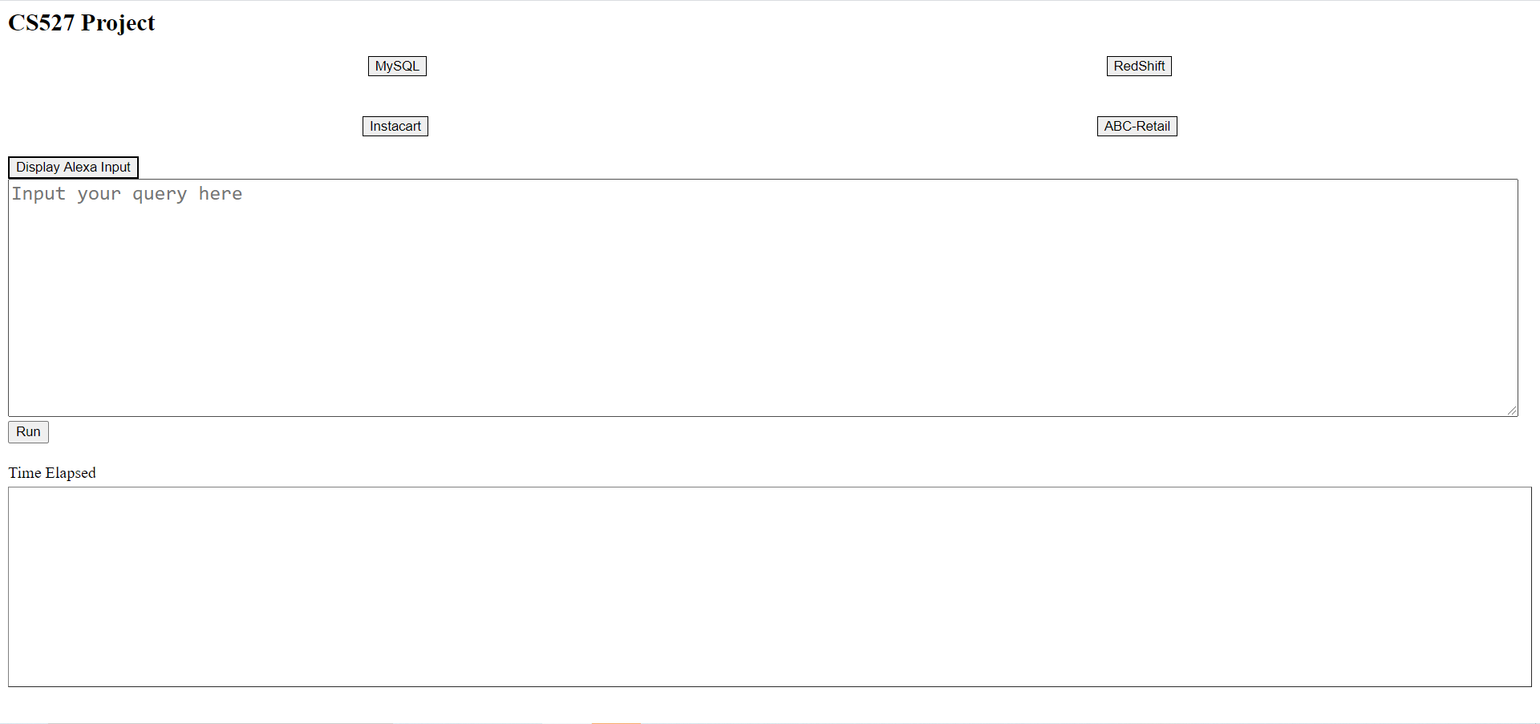
Web Application
Different from mid-term project, we add a new button ‘Display Alexa Input’. By clicking it, user could retrieve the SQL codes sent from Alexa voice input

Slide 4
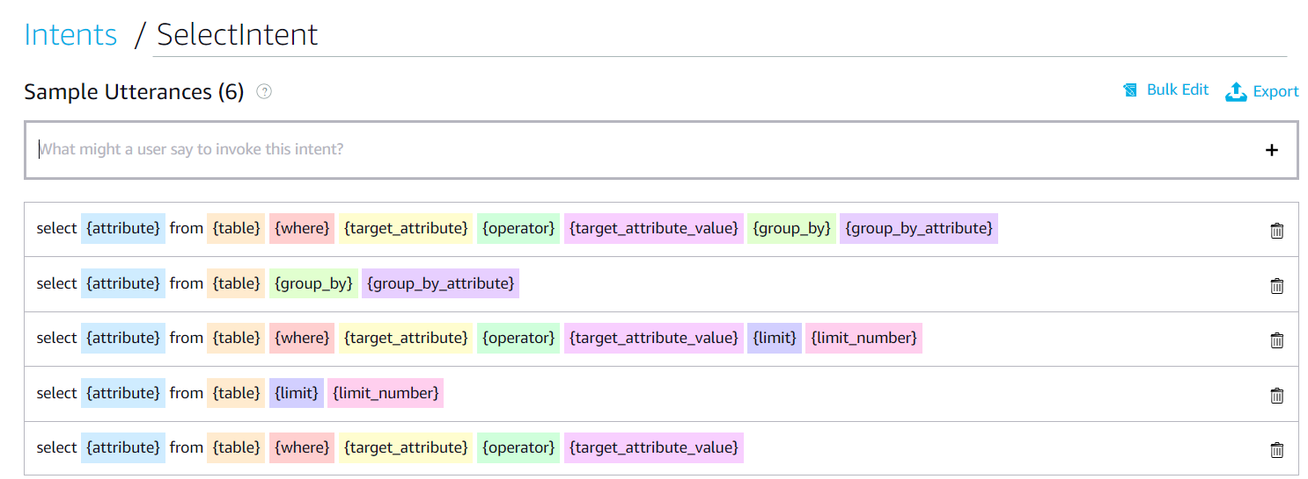
Alexa Intents
Structured module to process raw voice input.
Get corresponding parameters such as attribute, table and so on.

Slide 5
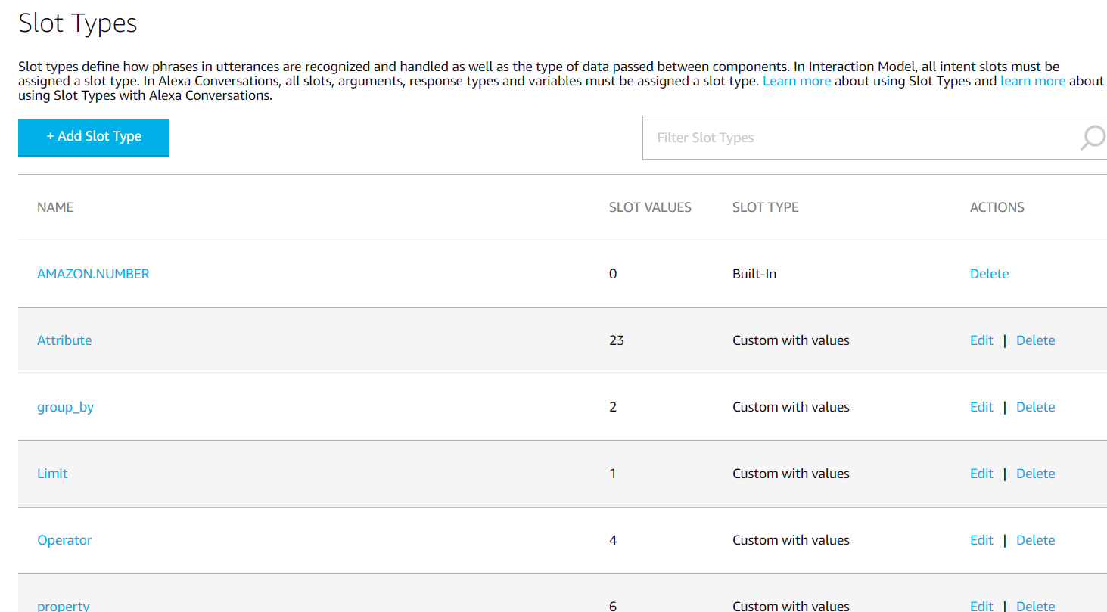
Slots
Set the property such as possible values of certain slots

Slide 6
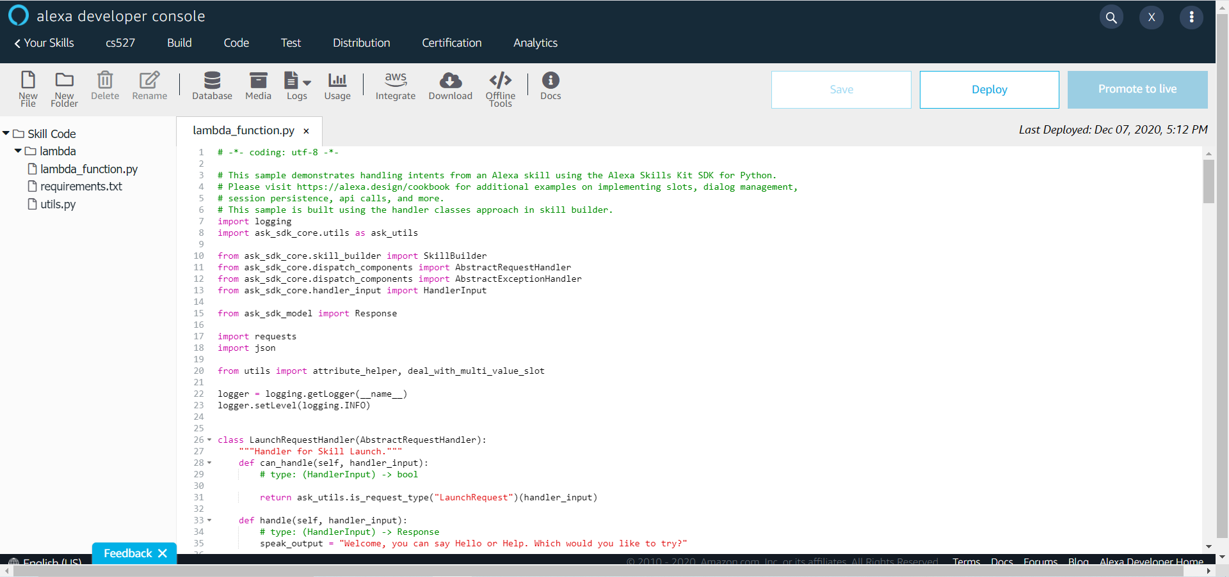
Alexa Lambda Function
Process the values we get from slots to the corresponding values in MySQL database. For example: transform attribute order number to order_number
Transform above input into SQL codes and send to the server

Slide 7
Demostration Video
https://youtu.be/04cOkJjyVzU
Thank you!

